Slide 1

Linux performance tuning
It is designed to teach senior Linux system administrators
the methodology of performance tuning.

Slide 2

Performance Monitoring Tools
Identify and explain the common system monitoring tools.
Discuss the sysstat utility command use.
Understand the Performance Co-Pilot Utility.

Slide 3

System Monitoring
It provides data regarding the actual timing behavior of the system.
Users can perform further analysis using the data provided by monitoring tools.
These tools display information about the Linux system, such as disk space utilization, CPU information, networking information and current rates of upload and download.
These tools information can be used by the way of command line or a graphical user interface.

Slide 4
Monitoring Tools
ps command
top command
free command
lsblk
Findmnt
df
du
GNOME System Monitor

Slide 5

Lab Session
Monitoring Processes Using the ps Command
ps [options]

Slide 6
Monitoring Process Using top
The top command is, just like ps, used to display running processes.
The top command provides a real-time report of process activities as it updates its display every few seconds.
Top is very useful to figure out which users and processes are consuming the most system resources at any given time.

Slide 7
Lab Session
Monitoring Processes Using the top Command
top –n 1 (option terminates the program after a single display of the process list.)

Slide 8
Monitoring Memory Usage
The free command lists both free and used physical memory and swap memory.
free [OPTIONS]

Slide 9

Lab Session
Monitoring Processes Using the ps Command

Slide 10
Monitoring File System Usage
lsblk
df –h
du

Slide 11
Lab Session

Slide 12
Using GNOME System Monitor
gnome-system-monitor

Slide 13
Lab Session

Slide 14
Sysstat Package Utilities
It provides utilities for Linux performance monitoring.
This is the best tool I found for the debugging the performance issue on your Linux systems.
Sysstat is an open source and freely available tool.
mpstat
iostat
pidstat
tapestat
cifsiostat
sar

Slide 15
System Activity Reporter - SAR
Using sar you can monitor performance of different Linux subsystems (CPU, Memory, I/O..) in real time.
The System Activity Reporter SAR, can display a lot of information about your computer and save that information to files for later analysis. This program and its related tools are part of the sysstat package.
SAR command can be used interactively.
To use it noninteractively, an agent is executed at a scheduled time using the cron command to collect data.
Cron file name is in /etc/cron.d/sysstat which runs the /usr/lib64/sa/sa1 and /usr/lib64/sa/sa2 commands.

Slide 16
System Activity Reporter - SAR
Some configuration can be done in the /etc/sysconfig/sysstat file. The /etc/sysconfig/sysstat file is read by the sa1 and sa2 scripts and allows some configurable options for the sar command.
For example, change the HISTORY variable to set the number of days archives are kept for the sar command.

Slide 17
System Activity Reporter - SAR
Advantages:
Cumulative stats data will be available.
Continuous monitoring of system stats.
Able to fetch system stats at any point of time.
Daily System performance will get captured. For 30 days
No need of manual intervention for collecting stats.
Quick stats overview at any given time.
24 hours system stats will get collected.

Slide 18
Lab Session
SAR

Slide 19
Sysstat Package Utilities
iostat : Reports all statistics about your CPU and I/O statistics for I/O devices..
mpstat : Details about CPUs (individual or combined)..
pidstat : Statistics about running processes/task, CPU, memory etc.
tapestat : Used for the statistics for tape drives attached to Linux system.
cifsiostat : Reports statistics on shared file systems, printers, or serial ports over a network.
sar : Save and report details about different resources (CPU, Memory, IO, Network, kernel etc..).

Slide 20
Sysstat Package Utilities
Features of the Sysstat Package Utilities
Users can configure the length of statistical data history to be archived.
Users can save statistical data in a file for future inspection, and can export in different file formats, such as CSV, JSON, and XML.
Users can generate graphs using statistical data. For example, the isag command enables a user to plot data stored in a daily data file by a previous sar run.
The sysstat package utilities automatically select the measurement units to display sizes for easier reading.

Slide 21
Using Systemd Timer
Scheduling tasks with Systemd Timer
With the advent of systemd in Red Hat Enterprise Linux 7, a new scheduling function is now available: systemd timer units. A systemd timer unit activates another unit of a different type (such as a service) whose unit name matches the timer unit name. The timer unit allows timer-based activation of other units. For easier debugging, systemd logs timer events in system journals.
The sysstat package provides a systemd timer unit called sysstat-collect.timer to collect system statistics every 10 minutes.

Slide 22
Viewing Hardware Resources
Hardware Resources:
Before tuning the performance of a system, it is important to understand the theoretical capabilities of that system. The first step toward that understanding is to develop a hardware profile of the system that you want to tune.
CPU
Memory
Storage
Networking

Slide 23
Viewing Hardware Resources
Reviewing Kernel Messages:
The easiest and most direct source of hardware information is the running Linux kernel. The kernel exposes information structures through the /proc file system, the /sys file system.
Kernel messages are written to a preallocated ring buffer known as the dmesg buffer.
dmesg command is used to get ring buffer messages.

Slide 24
Lab Session
IOSTAT: Reports all statistics about your CPU and I/O statistics for I/O devices.
Command to install on different Distros:
On RedHat / CentOS / Fedora
yum install sysstat
On Debian / Ubuntu / Linux Mint
apt-get install sysstat

Slide 25
Lab Session
MPSTAT : Details about CPUs (individual or combined)..

Slide 26
Lab Session
PIDSTAT : Statistics about running processes/task, CPU, memory etc.

Slide 27
Viewing Hardware Resources
Reviewing Kernel Messages:
The easiest and most direct source of hardware information is the running Linux kernel. The kernel exposes information structures through the /proc file system, the /sys file system.
Kernel messages are written to a preallocated ring buffer known as the dmesg buffer.
dmesg command is used to get ring buffer messages.

Slide 28
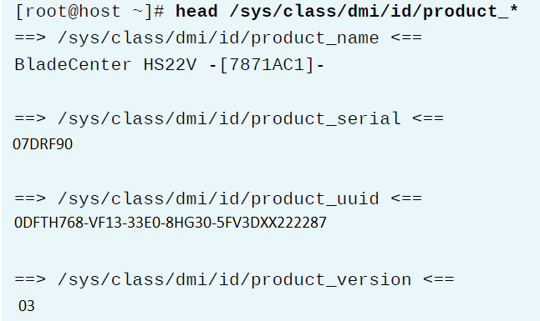
Retrieving SMBIOS/DMI Information

Slide 29
Retrieving Peripheral Information
lspci: lists devices connected to PCI buses in the system
lsusb: lists devices connected to system’s USB buses

Slide 30
Lab Session
Portable Hardware Locality (hwloc)
Listing Hardware Configurations (lshw)

Slide 31
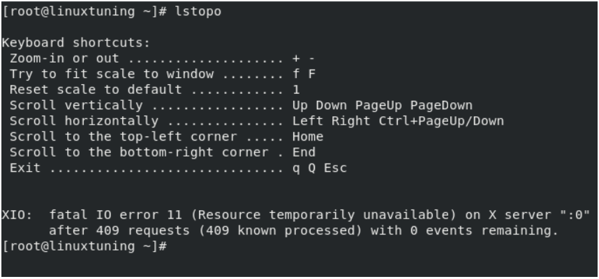
Portable Hardware Locality (hwloc)

Slide 32
Introducing the Proc File System
The proc file system is a pseudo file system that provides an interface to kernel data structures.
It is a virtual file system created on fly when system boots and is dissolved at time of system shut down.
The kernel mounts the proc file system on the /proc during boot time.
The files in the /proc directory having read-only permissions for static information and writable for configurable settings and kernel tunables.

Slide 33
Introducing Kernel Tunables
The Linux kernel keeps the information and tunables to user-space through the /proc directory.
The /proc/sys subdirectory contains configurable parameters for tuning kernel behavior.
Most files in /proc/sys are writable by root and modifying files in /proc/sys causes immediate changes in the running system.
Since all /proc/sys file changes write directly to the kernel in memory, changes are not persistent across reboots. Kernel tunable settings will revert to a kernel module's default settings unless configured persistently in appropriate configuration files.

Slide 34
Modifying Kernel Tunables
Use an editor or redirection to modify files in the /proc/sys directory.
Use the sysctl command to set a parameter by name.
Create entries for parameters in configuration files in the /etc/sysctl.d directory
/etc/sysctl.d/*.conf
/run/sysctl.d/*.conf
/usr/lib/sysctl.d/*.conf

Slide 35
Introducing the Sysfs File System
The sysfs file system is also a pseudo file system.
It is a virtual file system created on fly when system boots and is dissolved at time of system shut down.
The kernel mounts the sysfs file system on the /sys during boot time.
The files in the /sys directory provide access to information and parameters for devices, file systems, and other software loaded as a kernel module.
The files in the /sys directory having read-only permissions for static information and others are writable settings.

Slide 36
Managing Resource Limits
Limiting System Resources with ulimit
The shell contains a built in command called "Ulimit" which allows you to display and set resource limits for users. The systems resources are defined in a file called "/etc/security/limits.conf". Ulimit can then be used to view these settings.

Slide 37
Managing Resource Limits
Limiting System Resources with ulimit
The shell contains a built in command called "Ulimit" which allows you to display and set resource limits for users. The systems resources are defined in a file called "/etc/security/limits.conf". Ulimit can then be used to view these settings.
The defining of system resource limitations is critical to a smooth running system. By defining restrictions to users, you are safe guarding your system from running out of memory, space or from a rouge process that spawns multiple processes. Limits can be placed globally, individually or by group.

Slide 38
Configuring Persistent ulimit Rules

Slide 39
Lab Session
tom user must be limited to a maximum of 12 processes and this should be a hard limit.
Users in the db group must be limited to 128 MiB of virtual memory and this should be a hard limit (128 MiB equals 131072 KiB)

Slide 40
Lab Session
Setting Limits for Services
Configure the crond service with a cgroup MemoryLimit of 1G, using the command line and default slice.

Slide 41

Thank You!

